Slide 1
Category review: Chips
September 2022
Retail Analytics
Brand note: If client logo is not required, use alternate title page layout right click slide thumbnail > Layout > Title

Slide 2
Notes:
To view Privacy video explaining how important data privacy is to Quantium, please click here: https://www.youtube.com/watch?v=Zq1QDAkoRzU
or here Q:\Company Reference\Brand & Design\Brand videos\Q Privacy.mp4
At Quantium, we believe that data is the behavioural footprint of humanity and that it has to be treated with the utmost care and responsibility.
Histories, attitudes, indeed lives are stored within it in ways that aren’t always apparent – and that’s what makes its potential so powerful.
To work with it responsibly, sensitively, we set ourselves the highest data privacy protection and governance standards.
We have spent 17 years perfecting privacy-by-design and secure-by-design principles. Central to this is not holding any personally identifiable information about people –
we neither receive it, and put the necessary protections in place to be unable to decipher it.
Every aspect of handling data is safeguarded: from its de-identification, to its encryption – data security is paramount and of the highest grade.
We pride ourselves on gaining the trust of iconic organisations around the world through years of securely working with their data,
and in turn the trust that builds with their stakeholders.

Slide 3
Executive summary
01
Task 1
DATA PREPARATION AND CUSTOMER ANALYTICS
The recommended customer segments to focus commercialization on are Mainstream and the midage and young singles/couples customers
The chips brands to commercialize more are kettles, Pringles, Smiths, Doritos, and Thins
The pack sizes to commercialize more are 175, 150, 134, 110, and 170
02
Task 2
EXPERIMENTATION AND UPLIFT TESTING
There was a significant increase in number of customers and total sales for at least two of the three months for trial stores 77 and 88
However, this change did not apply to trial store 86 maybe because of a difference in trial implementation

Slide 4
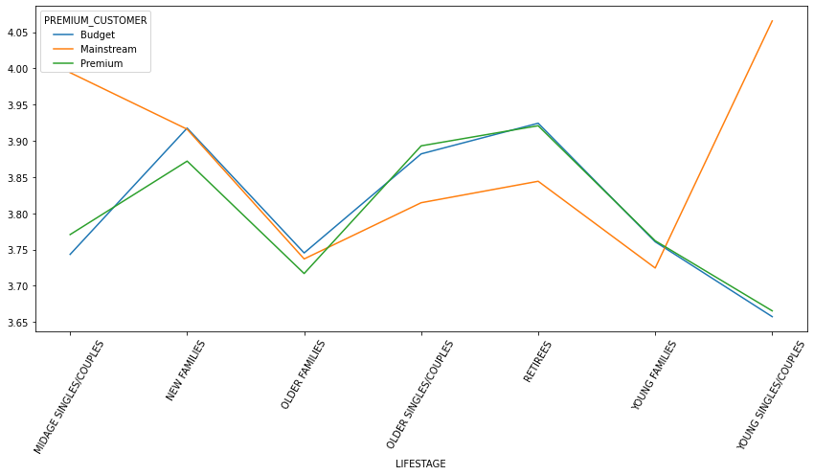
01
Category
The mainstream and midage and young singles/couples had significantly higher values for average unit prices hence they comparatively spent more and buy more expensive chips than the other categories

Slide 5
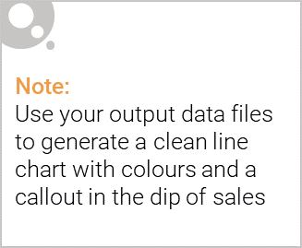
Callouts For Categories
The recommended Categories were observed further and insights showed that they purchased some brands and pack sizes more than others:
Increase the supply of the following brands: Kettle, Pringles, Smiths, Doritos and Thins in order of importance.
Increase the supply of the following pack sizes: 175g, 150g, 134g, 110g, and 170g in order of importance

Slide 6
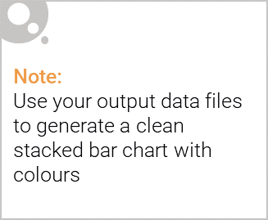
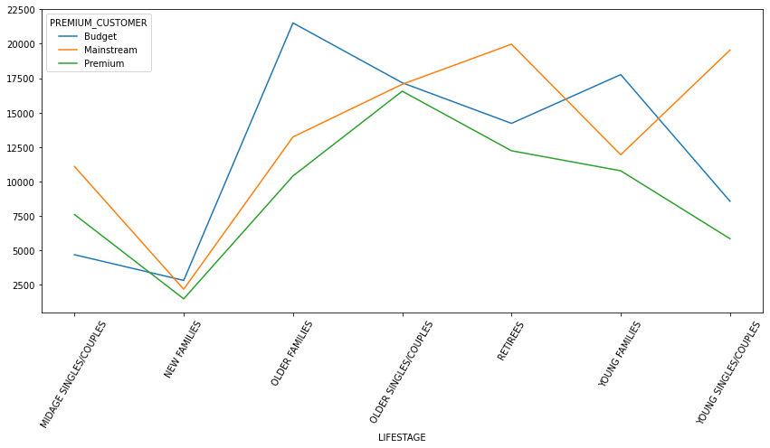
Editable (delete this)
The Proportion of Customers by Affluence and Life Stage

Slide 7
02
Trial store performance
Control stores selected for each trial store were as follows:
Store 77 - Store 233
Store 86 - Store 155
Store 88 - Store 237

Slide 8
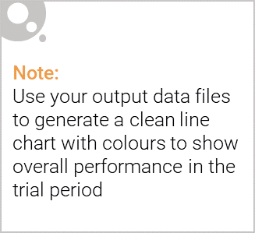
Explanation of the control store vs other stores
There control stores for each trial store were selected based on the similarities in performances before the pre-trial period of February 2019.
A control store has two main properties:
Has transactions every month from July 2018 to the pre-trial period
Has the best control score which is computed from total sales and total number of customers. The best control score is that which is closest to the trial score
The rest of the stores are considered as “Other Stores” and are not used in the experimental testing

Slide 9
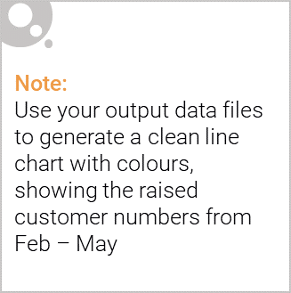
Trial Store Performance Evaluation results and recommendation
Upon selection of control stores per trial stores, the testing was done on next three months and the performances increased for stores 77 and 88 for at least two of the three months.
Hence the trial experiment was successful
However, trial store 86 had no increase in performance which may be affected by the trial implementation method.

